Slide 1
Robust Memory-augmented Neural Network for Few-shot Learning Application
Speaker: 陳奕瑒
Advisor: Prof. An-Yeu (Andy) Wu, Ric Huang
Date: 2023/05/03

Slide 2
Target
Check out the noise effect of controller to the accuracy of 5-ways 1-shot application
Simulate In-memory computing non-ideal effect on hardware
Notes:
學長給我的目標

Slide 3
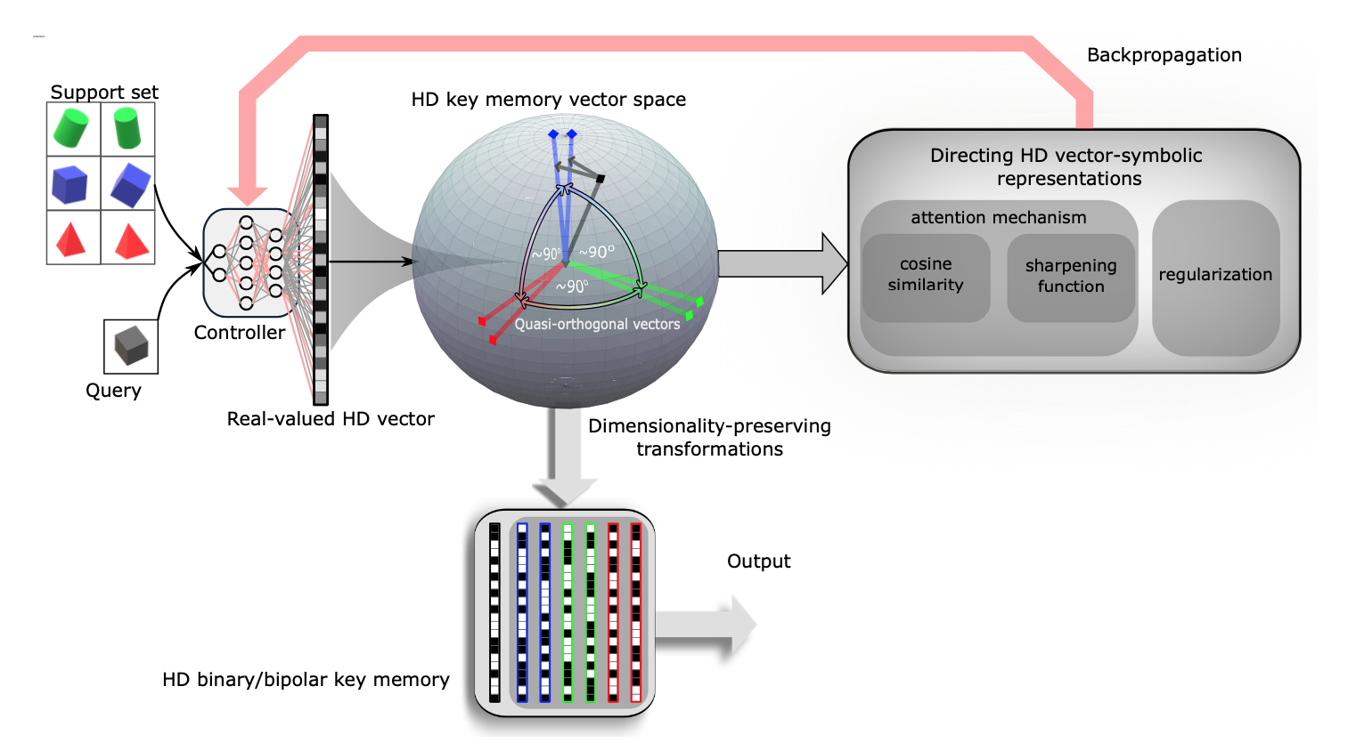
Memory-augmented Neural Network
Support set become a key memory after propagating through controller.
Similarly, the query set become HD vectors and the output is decided after the In-memory searching.
Notes:
MANN + Controller 的 slide introduction 要寫出來 前半部分析 後面針對similarity 做簡化跑實驗

Slide 4
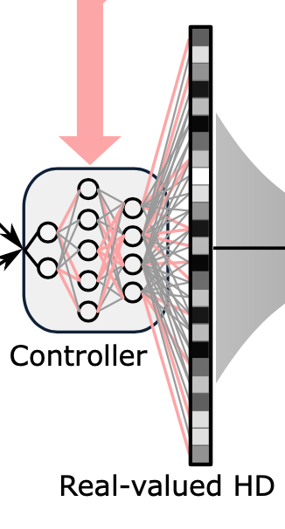
Network Architecture of the Controller (1/2)
8-bits weight quantization
CONV
Noise
ReLU
X
4
8-bits ReLU quantization
Controller has four convolutional layers and ReLU activation functions.
FC Layer
Notes:
Network architecture (uniform quantization) 8 bits

Slide 5
Network Architecture of the Controller (1/2)
8-bits weight quantization
CONV
Noise
ReLU
X
4
8-bits ReLU quantization
Controller has four convolutional layers and ReLU activation functions.
We add noise on weight of convolutional layers to simulate IMC non-ideal effect.
FC Layer
Notes:
Network architecture (uniform quantization) 8 bits

Slide 6
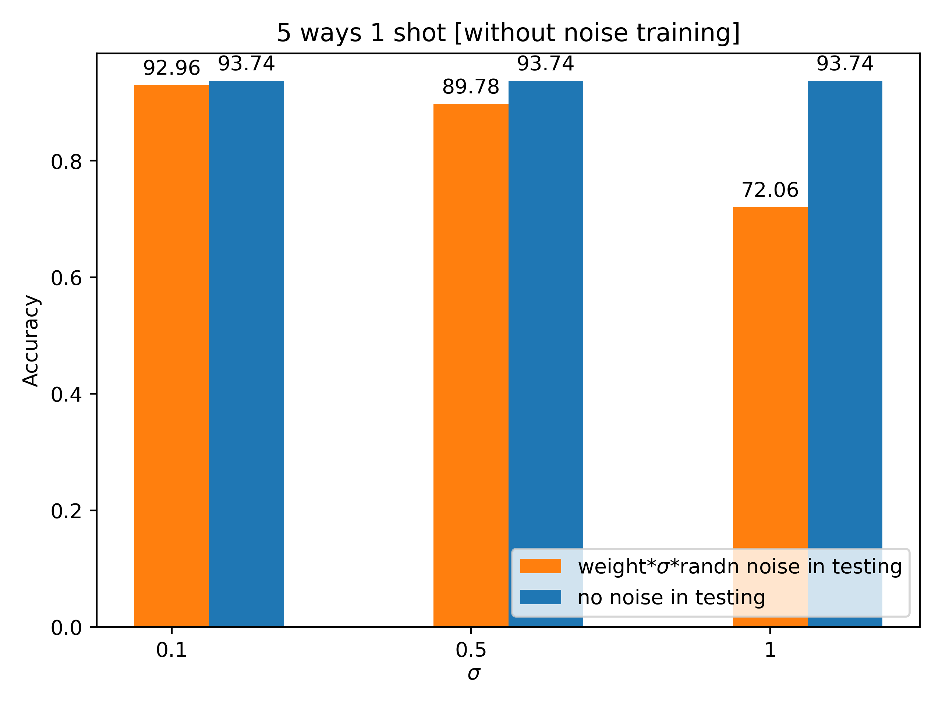
Experiment 1: training without noise (1/2)
Average accuracy of different noise
Noise is applied only on testing stage
Notes:
Accuracy of different noise variance

Slide 7
Experiment 1: training without noise (1/2)
Average accuracy of different noise
Noise is applied only on testing stage
Notes:
Accuracy of different noise variance

Slide 8
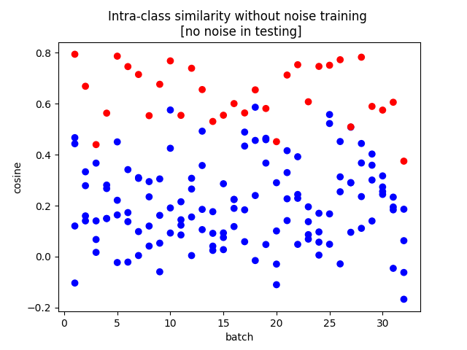
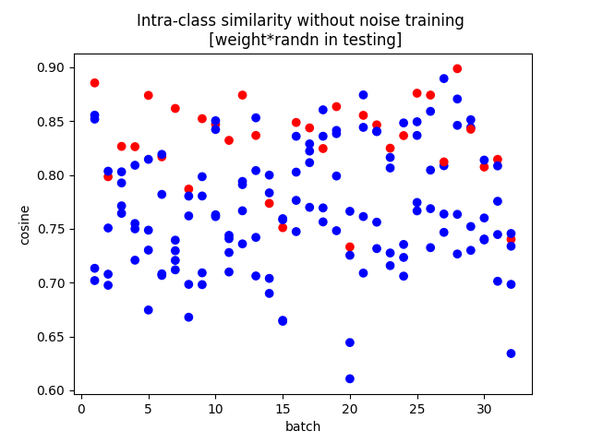
Experiment 1: training without noise (2/2)
Intra-class similarity of query memory and key memory
: similarity of the target label
: similarity of the non-target label
Notes:
Intra-class (標註、圖例) 寫更多說明 老師要看什麼？！

Slide 9
Experiment 1: training without noise (2/2)
Intra-class similarity of query memory and key memory
: similarity of the target label
: similarity of the non-target label
Non-target and target all have high similarity => ambiguous
Notes:
Intra-class (標註、圖例) 寫更多說明 老師要看什麼？！

Slide 10
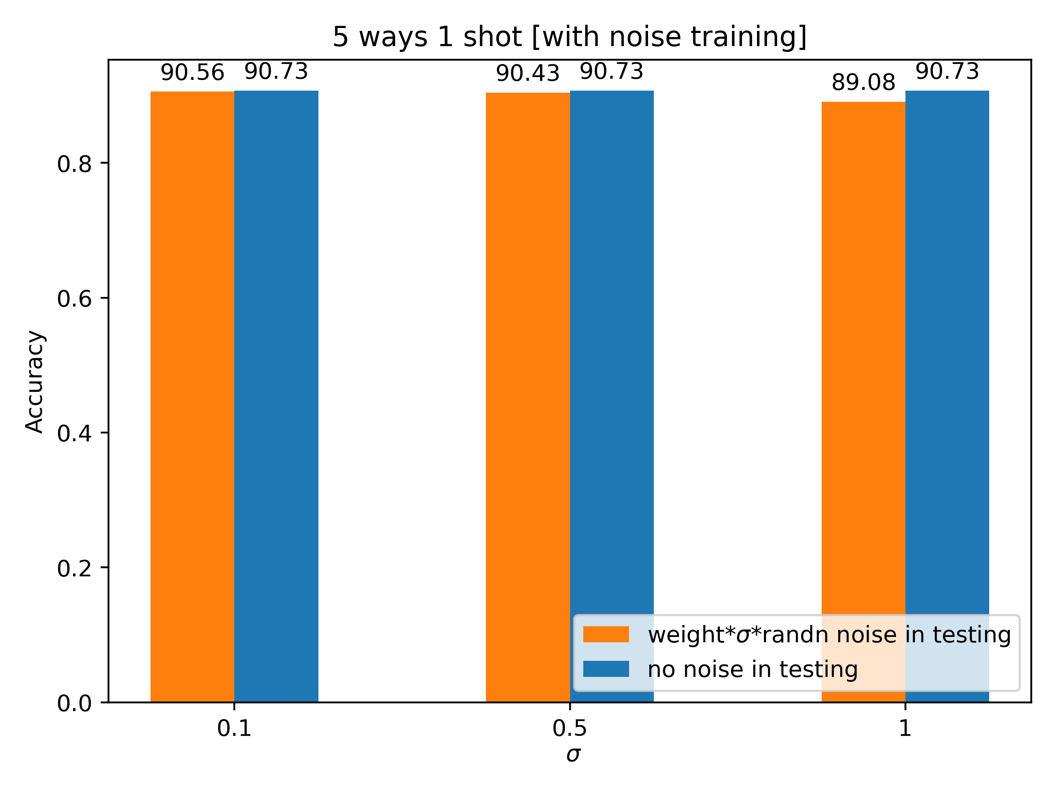
Experiment 2: training with noise (1/2)
Average accuracy of different noise
Left : training without noise
Right : training with standard noise
Notes:
Training with noise and the accuracy result (5000 episodes) weight*randn train出來的結果

Slide 11
Experiment 2: training with noise (1/2)
Average accuracy of different noise
Left : training without noise
Right : training with standard noise
Notes:
Training with noise and the accuracy result (5000 episodes) weight*randn train出來的結果

Slide 12
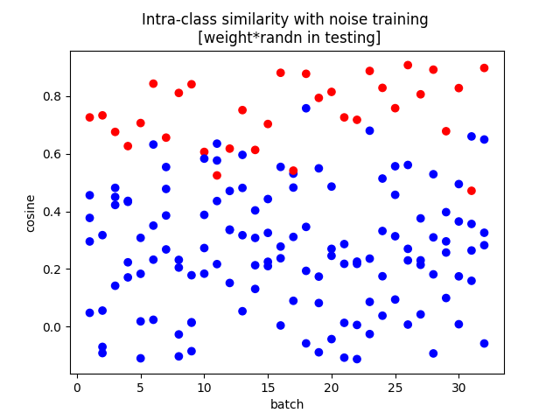
Experiment 2: training with noise (2/2)
Intra-class similarity of query memory and key memory
Left : training without noise
Right : training with standard noise
There is more similarity difference between target and non-target
Notes:
Conclusion and future goal

Slide 13
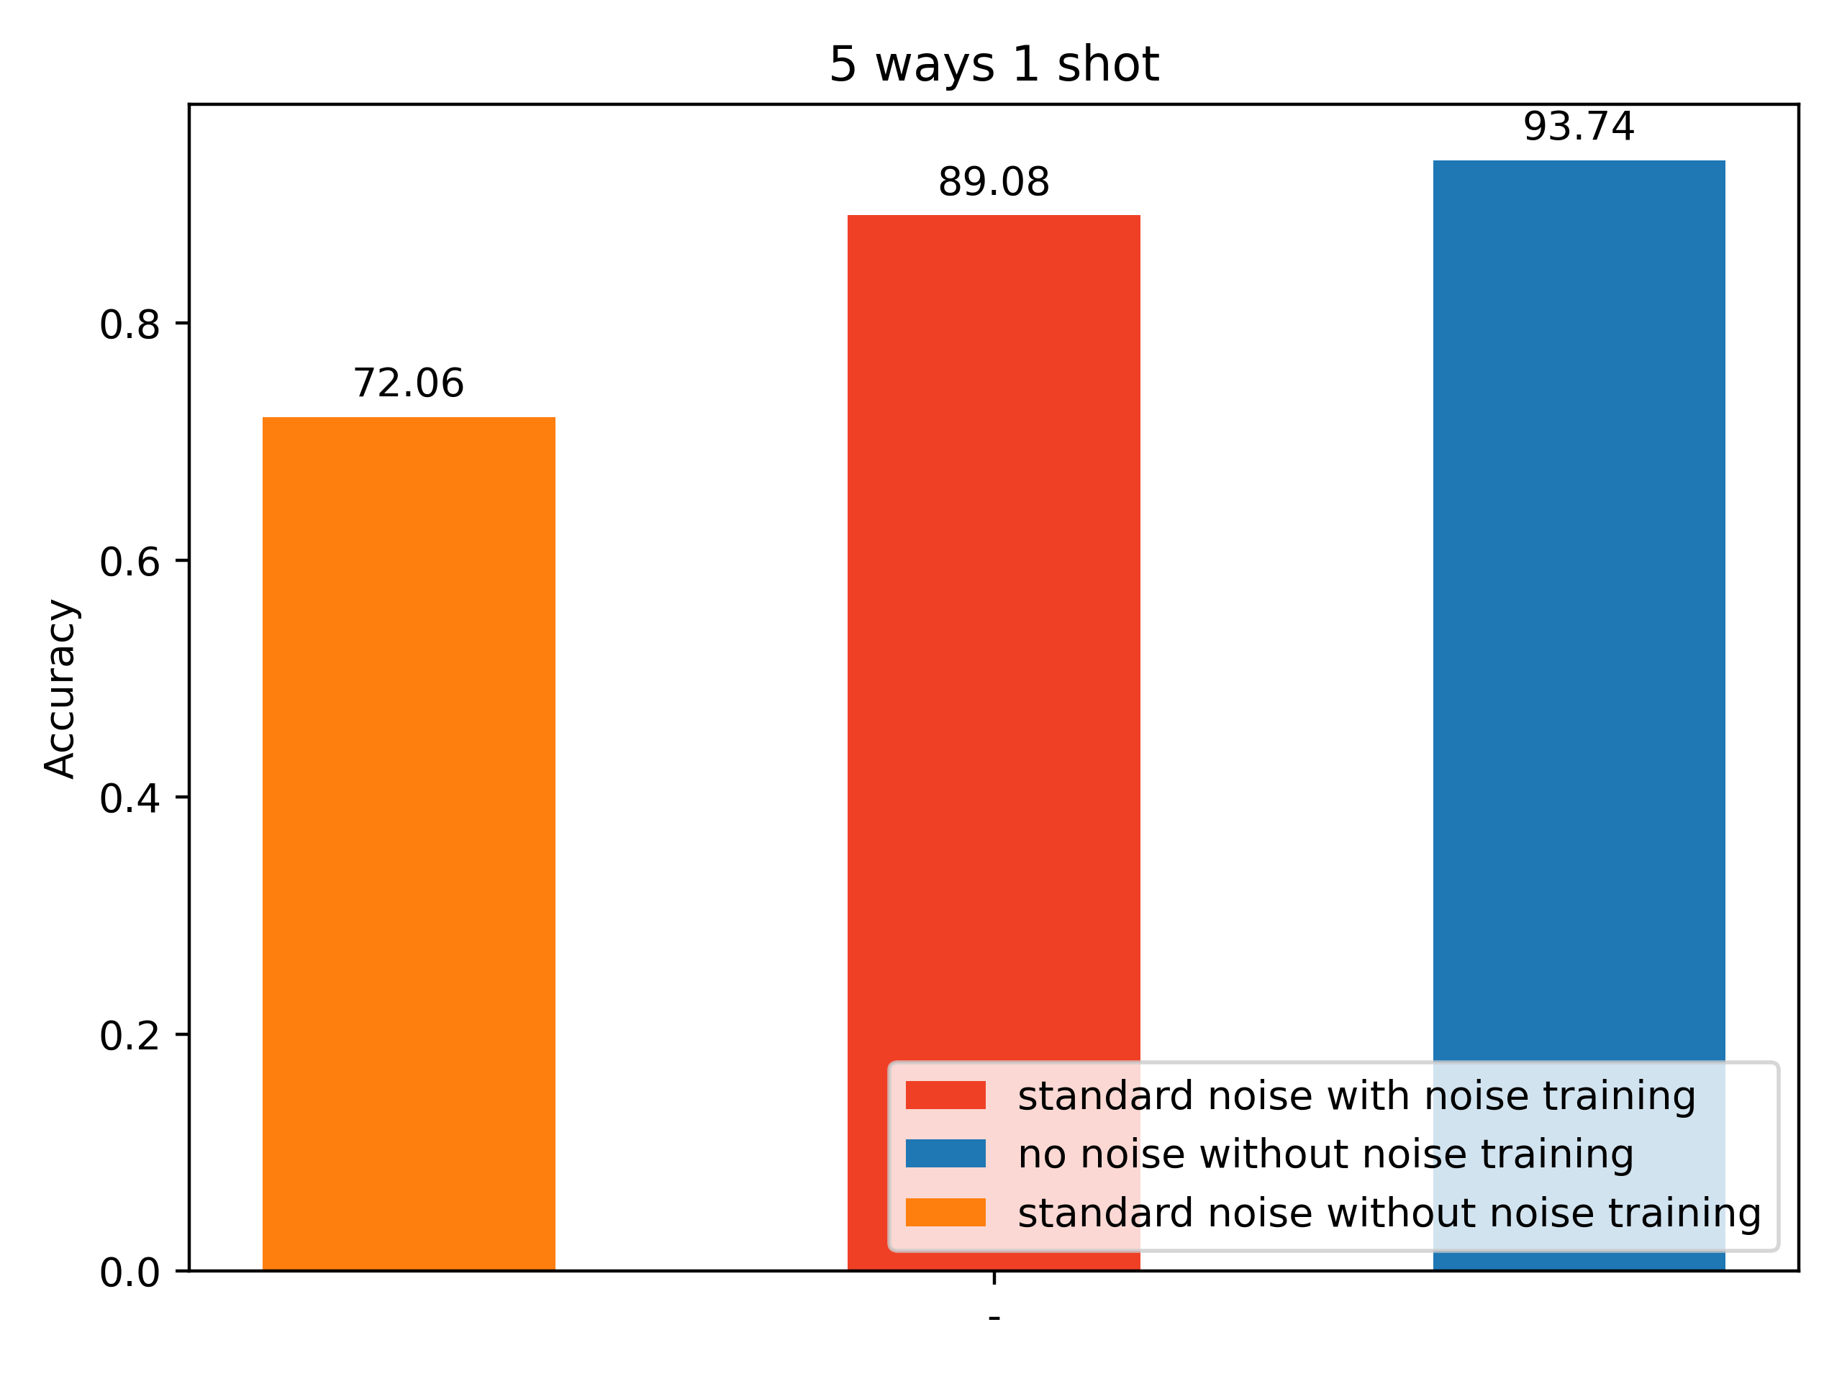
Conclusion
Although the accuracy of model trained with standard noise drops about 4.66% compared to the model trained without noise, it remains robustness to different variance of noise.
Notes:
加圖做總結

Slide 14
Future work
Notes:
Reproduce

Slide 15
Thanks for your listening !

